Slide 1

Software Testing Team
TL /Mostafa waled
Mostafa Mohmed
Salma Abdul-Ati
Fatma Rabie

Slide 2

Demo
E-commerce
web site

Slide 3

Goals
Conducting a comprehensive physical test of several ways for a real site and the ability to detect errors , Bugs , document them effectively and clearly for decision makers
Manual testing
01
Data base testing
02
ApI testing
03
Performance testing
04
Automation testing
05
CI & CD
06

Slide 4

Manual Testing
Using testing technics to detect Bugs like :
Smoke testing
Black box testing
Exploratory testing
Use management tools to make Bug tracking :
JIRA Management tool
https://smeshady91.atlassian.net/jira/software/projects/ZC/boards/2?atlOrigin=eyJpIjoiMjlhNmFjYTY3N2NkNGY2ZTgzYmQ0ZmMwMmYwMDc0YzAiLCJwIjoiaiJ9

Slide 5
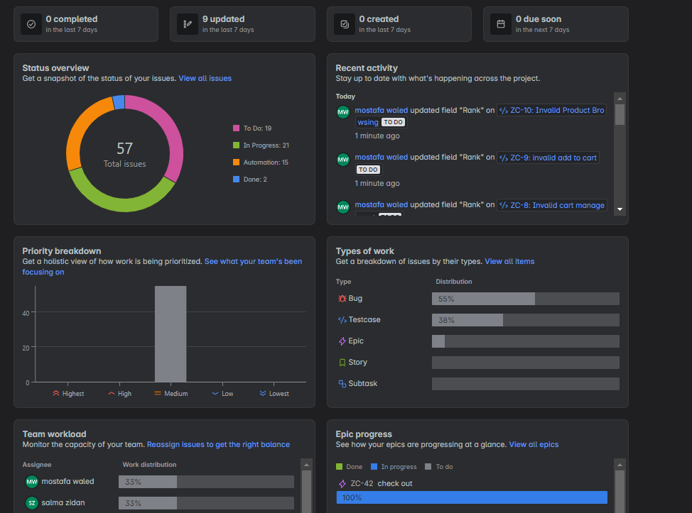
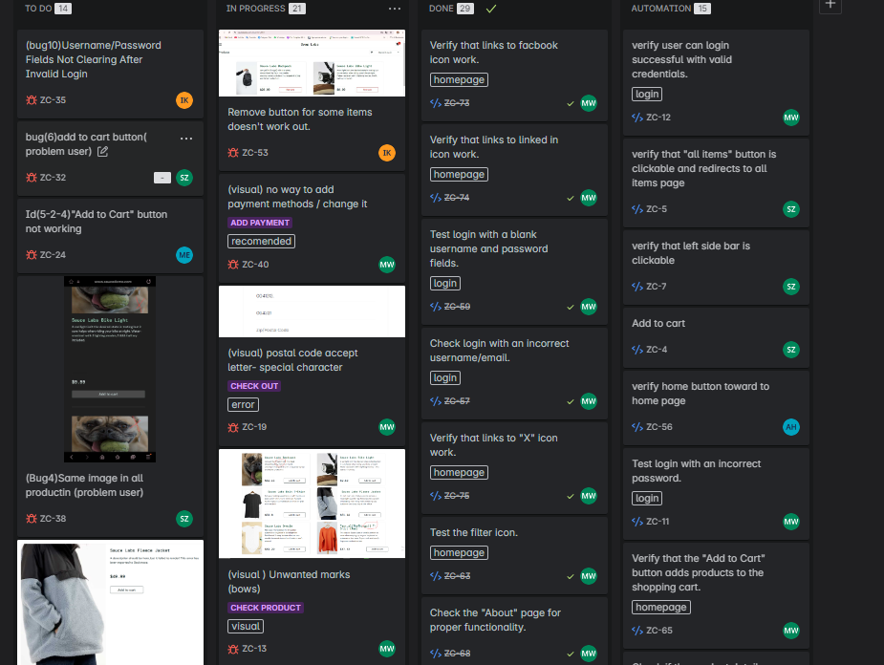
Bug Tracking

Slide 6
Database Testing
Managed test data for functional and performance scenarios.
Validated data inputs/outputs across UI and API interactions

Slide 8
API Testing
Set up Postman for API testing and validated initial endpoints.
Expanded API test coverage by adding more endpoints and verifying data accuracy.
Integrated API testing with Jira for issue tracking.
Executed a full API test suite and documented procedures for future use.

Slide 9
API testing Q1

Slide 10
API testing Q1

Slide 11
API testing Q1

Slide 12
API testing Q2

Slide 13
Performance Testing
Developed and executed load and stress tests using JMeter/Gatling .
Analyzed response times , load handling , and scalability .
Optimized the framework for better performance and reusability.
Generated detailed reports with key performance metrics.

Slide 14
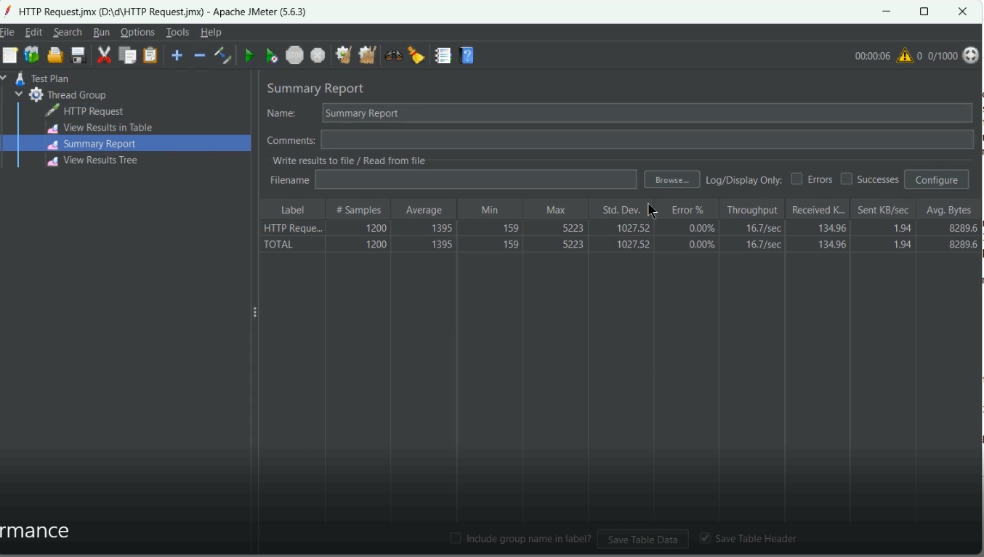
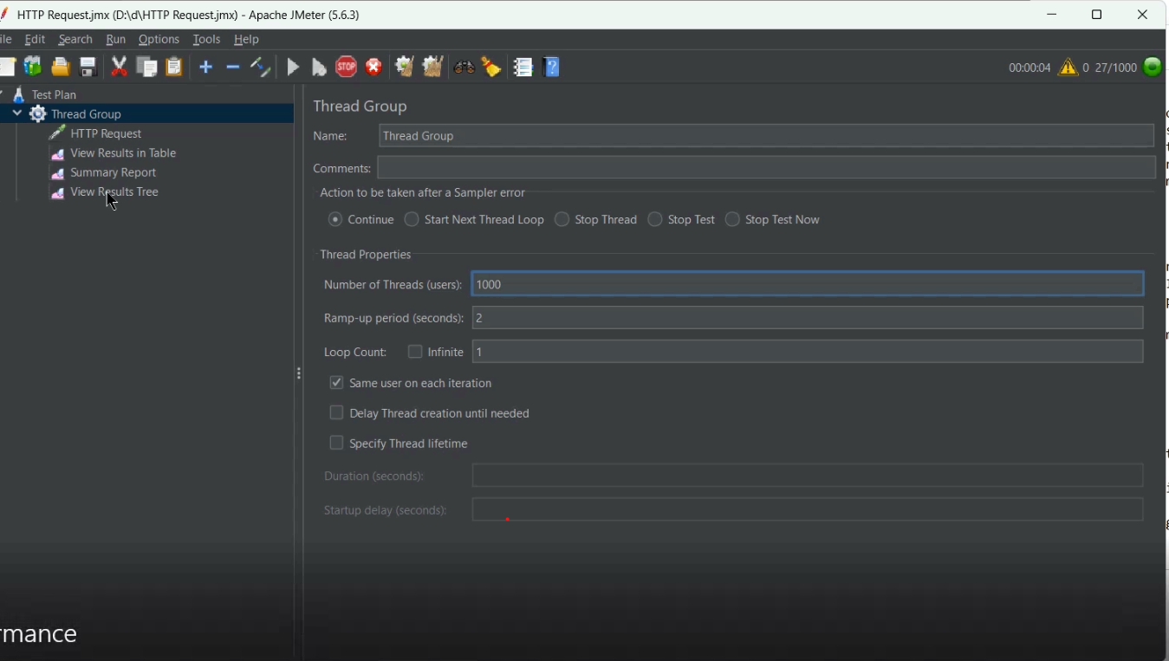
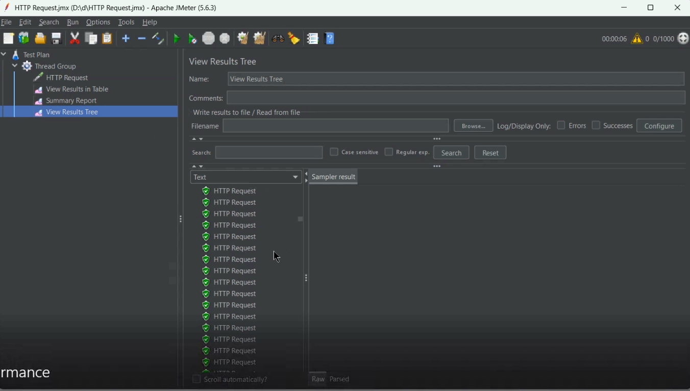
Performance Testing

Slide 15

Automation testing
Set up a testing environment using Selenium WebDriver .
Created a scalable folder structure for test scripts and reports.
Developed and automated initial test cases for basic UI functionality.
Automated functional workflows (e.g., login, form submissions).
Integrated TestNG/JUnit for generating detailed test reports.
Enhanced UI test cases for complex scenarios like responsive design and cross-browser compatibility.
Refactored the framework for better performance and reusability using Page Object Models .
Executed a full suite of automated tests (UI, functional, API, performance

Slide 16
CI / CD
Integrated the testing framework into a CI/CD pipeline using tools like Jenkins .
Ensured the framework was ready for continuous integration and deployment.
Enabled seamless automation of the testing process within the development workflow.

Slide 17

Thanks

